Slide 1


Residential Steward Handyman Program
Reliable home repairs, maintenance, punch lists and seasonal care — organized around long-term stewardship.
• Protect your home
• Maintain value
• Elevate comfort and safety
Client brochure • Residential

Slide 2
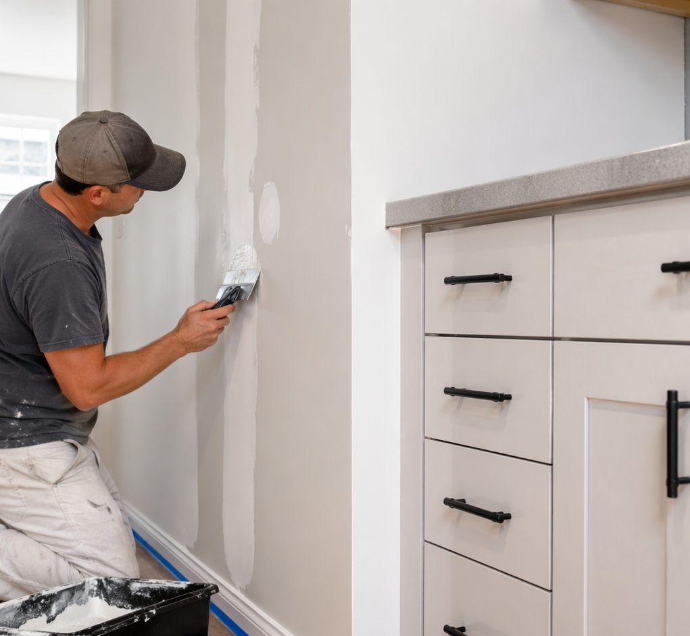
What the program does
A single trusted team for the repairs and maintenance that pile up.
One place for the little things
We help homeowners stay ahead of daily repairs, small installations, safety improvements, seasonal maintenance, and punch lists without juggling multiple vendors.
Steward mindset
Our goal is not one-and-done work. We document what we see, prioritize what matters, and help you maintain your home over time.
Designed for busy households
Ideal for homeowners, new movers, seniors, veterans, families, second-home owners, and landlords with small residential properties.
SPS Midwest • Protect, Maintain, Elevate
Residential

Slide 3
Common residential services
Representative services that can be scheduled individually or bundled into visits.
Category
Examples
Interior handyman
Doors, hardware, drywall patches, caulking, TV mounting, shelves, blinds, cabinet fixes, fixtures, fans, detectors, filters.
Exterior handyman
Gutters, storm/screen doors, weatherstripping, downspouts, siding/fascia/soffit touch-ups, mailbox, fence gates, deck/porch repairs.
Safety & accessibility
Handrails, grab bars, anti-slip treads, loose steps, thresholds, trip hazards, child-safety anchoring.
Carpentry
Trim, baseboards, casing, doors, shelving, built-in style units, deck boards, railings, exterior trim and small wood repairs.
Seasonal care
Holiday lights, snow/ice, yard cleanup, mulch, leaf removal, gutter cleaning, winterization and weatherproofing.
SPS Midwest • Protect, Maintain, Elevate
Residential

Slide 4
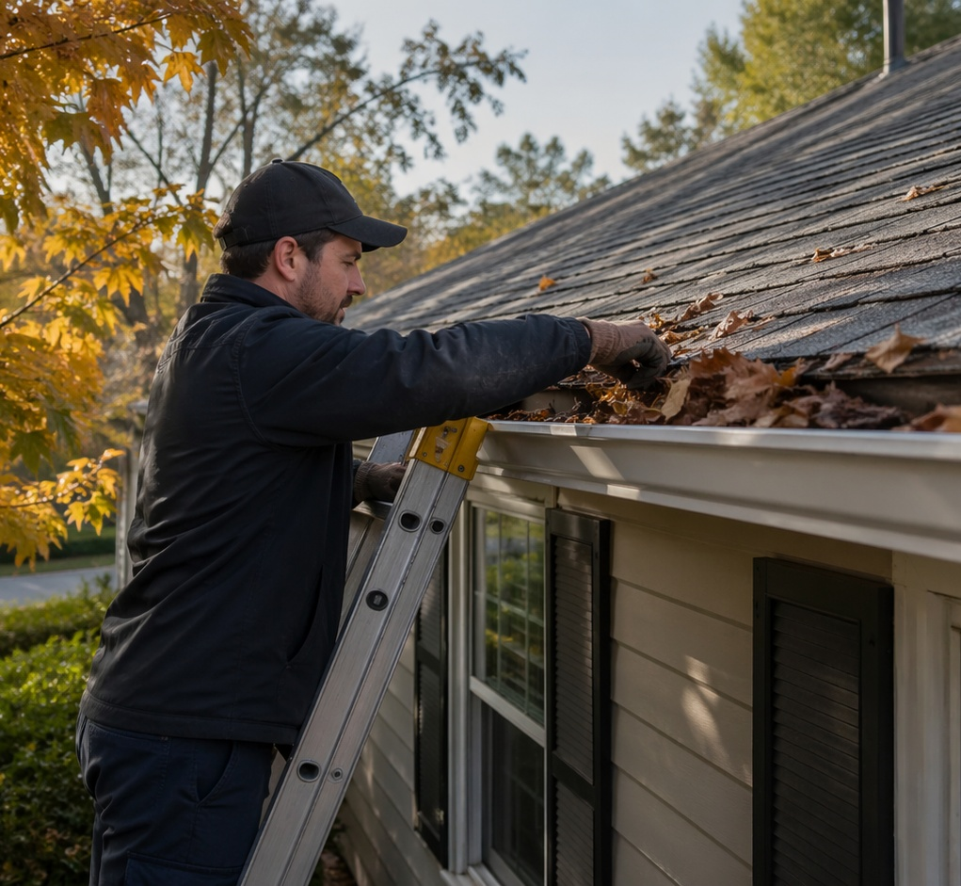
Flexible hour bank system
Reserve technician time before small issues become big ones.
How it works
Clients pre-purchase blocks of technician time on a monthly or annual basis and use those hours as needs arise for repairs, maintenance, and minor improvements.
Why it matters
Predictable costs, faster scheduling, fewer surprises, and a clearer path to keeping the home safe, functional, and well-maintained.
Best-fit uses
Recurring maintenance, move-in punch lists, seasonal tune-ups, aging-home upkeep, safety items, and minor improvements that never seem to get done.
SPS Midwest • Protect, Maintain, Elevate
Residential

Slide 5
How a Steward visit works
Simple, transparent, and built for repeat use.
01
02
03
04
05
Request service
Review scope
Complete work
Follow up
Maintain over time
Submit a request, send photos, or book through the website/portal.
We review the issue, clarify details, and determine the right visit type.
The technician works through the highest-priority items during the scheduled visit.
You receive next-step recommendations, reminders, and opportunities to book future care.
One-time jobs can turn into hour bank or seasonal maintenance plans.
SPS Midwest • Protect, Maintain, Elevate
Residential

Slide 6
Popular residential packages
Client-friendly bundles that make it easier to say yes.
Package
Best for
Value
New Homeowner Punch List
Recent movers
Installations, assembly, hanging, door adjustments, draft sealing, hardware, and early maintenance priorities.
Seasonal Steward Tune-Up
Busy homeowners
Spring/fall maintenance, gutters, filters, caulking, safety checks, and prioritized recommendations.
Winterization & Safety
Older homes / rentals
Hose bibs, weatherstripping, handrails, detectors, filters, steps, and cold-weather readiness.
Holiday Prep & Lighting
Holiday households
Lighting, décor support, guest-area touch-ups, entry safety, and post-season takedown options.
Ongoing Steward Hour Bank
Repeat clients
Reserved technician hours for repairs, maintenance, and minor improvements throughout the year.
SPS Midwest • Protect, Maintain, Elevate
Residential

Slide 7
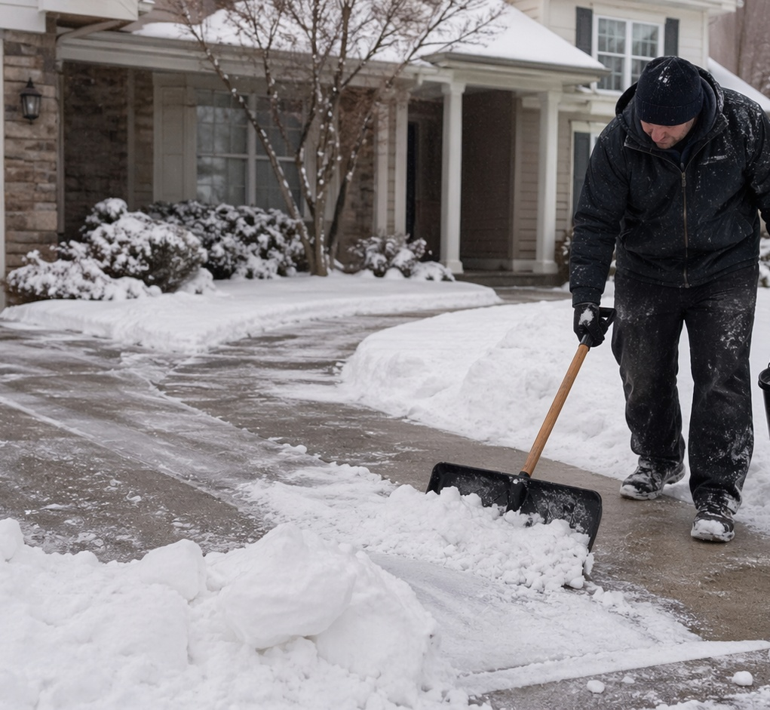
Seasonal care keeps the home moving
Seasonal services are practical, timely, and easy to bundle.
Weather-ready support
Snow and ice clearing, pre-storm treatment, winterization, draft sealing, and safety checks help protect the home during tougher months.
Curb appeal and comfort
Holiday lighting, yard cleanup, mulch refresh, leaf removal, and seasonal maintenance help the property look cared for all year.
Natural path to membership
Seasonal clients can easily move into an hour bank or maintenance plan once they experience the convenience of one reliable Steward team.
SPS Midwest • Protect, Maintain, Elevate
Residential

Slide 8
Why homeowners choose SPS Midwest
Practical benefits clients understand quickly.
Benefit
What it means for the homeowner
Trust
One consistent Steward team instead of random one-off vendors.
Convenience
Scheduling, reminders, follow-up, photos and service notes are organized.
Prevention
Small maintenance items are addressed before they become bigger costs.
Flexibility
Book one visit, a package, seasonal help, or ongoing hour bank support.
Clarity
Prioritized recommendations help clients decide what matters now and what can wait.
SPS Midwest • Protect, Maintain, Elevate
Residential

Slide 9

Ready to protect, maintain, and elevate your home?
SPS Midwest gives homeowners a dependable Steward team for repairs, punch lists, seasonal care, and ongoing maintenance.
• Book a visit
• Build a punch list
• Ask about hour bank options
Click the link to see if you're a fit: Residential Steward
Call/Text: 463-777-2916 • spsmidwest.com
• customer-care@spsmidwest.com
Residential brochure

