Slide 1
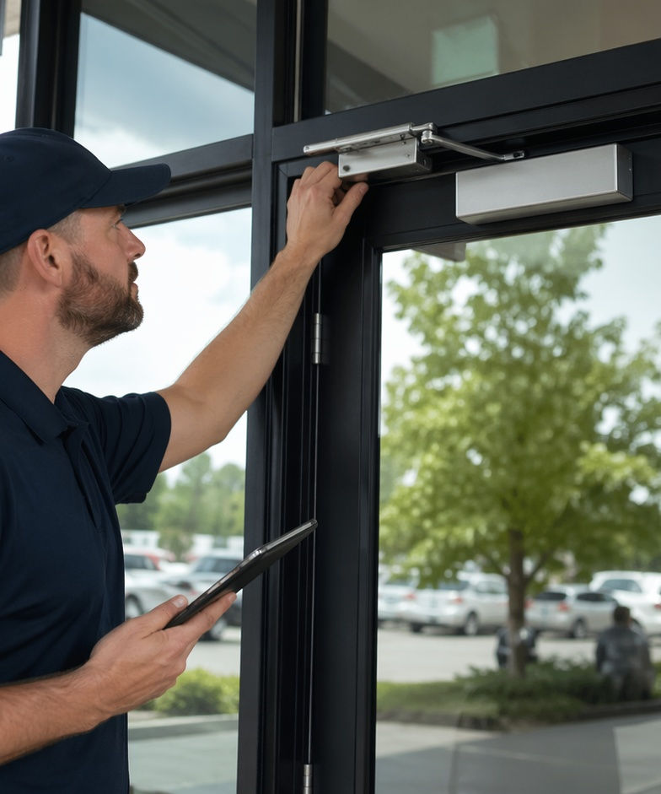
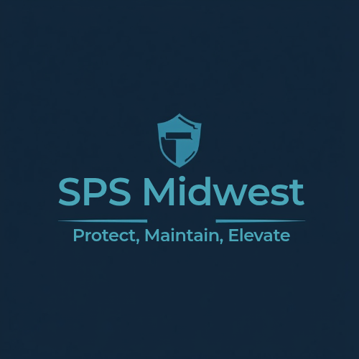
Commercial Steward Handyman Program
Reliable maintenance support for small businesses, properties, portfolios and multi-unit spaces.
• Reduce downtime
• Protect property value
• Simplify maintenance
Client brochure • Commercial

Slide 2
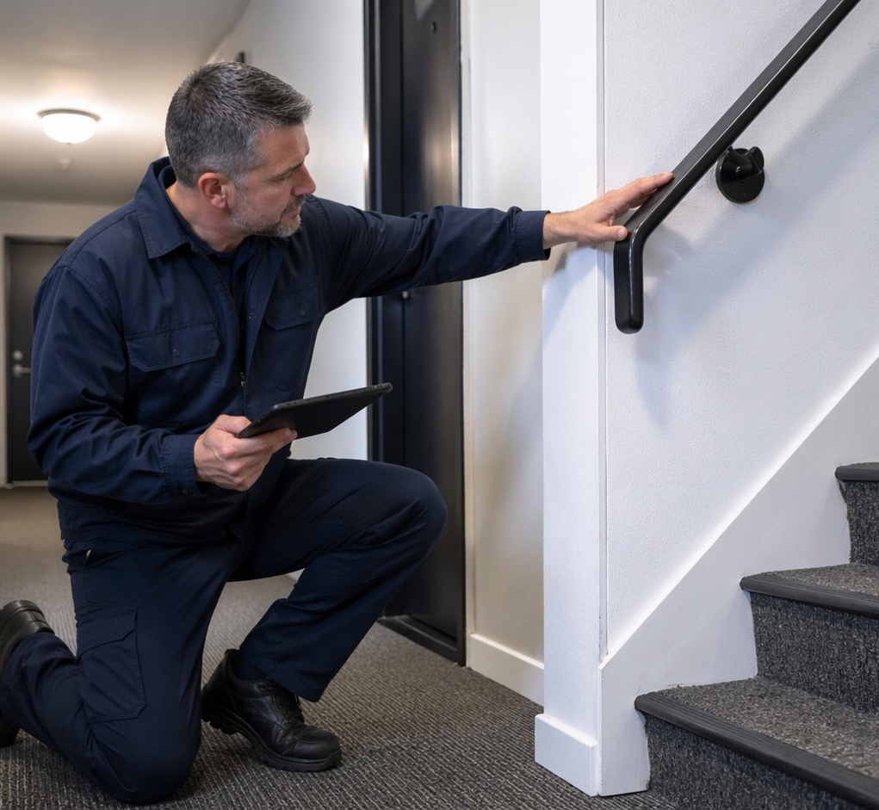
Maintenance support for business properties
A practical bridge between property management and larger trade work.
Who it serves
Small business owners, landlords, investors, property managers, HOAs, offices, retail spaces, and contractors needing overflow support.
What we solve
Recurring punch lists, tenant turnovers, small repairs, common-area maintenance, safety issues, and appearance items that affect operations.
One organized partner
We streamline scheduling, triage, documentation, and follow-up so property teams are not chasing multiple vendors for every small issue.
SPS Midwest • Protect, Maintain, Elevate
Commercial

Slide 3
Commercial service categories
Representative support options for property and business clients.
Category
Examples
Commercial handyman repairs
Door hardware, locks, hinges, closers, drywall, trim, restroom fixtures, light fixtures, shelving, signage and small installs.
Property maintenance
Common-area repairs, steps, rails, thresholds, caulking, weatherstripping, gutters, drainage, gates, access points and exterior touch-ups.
Turnover & make-ready
Move-out punch lists, drywall/paint touch-ups, hardware, filters, detectors, entry/access fixes and curb appeal items.
Recurring maintenance
Monthly routes, multi-property punch lists, planned maintenance days, portfolio-level support and priority scheduling.
Urgent support
Same-Day Steward for access, safety, leaks/stabilization, trip hazards and customer-facing issues.
SPS Midwest • Protect, Maintain, Elevate
Commercial

Slide 4
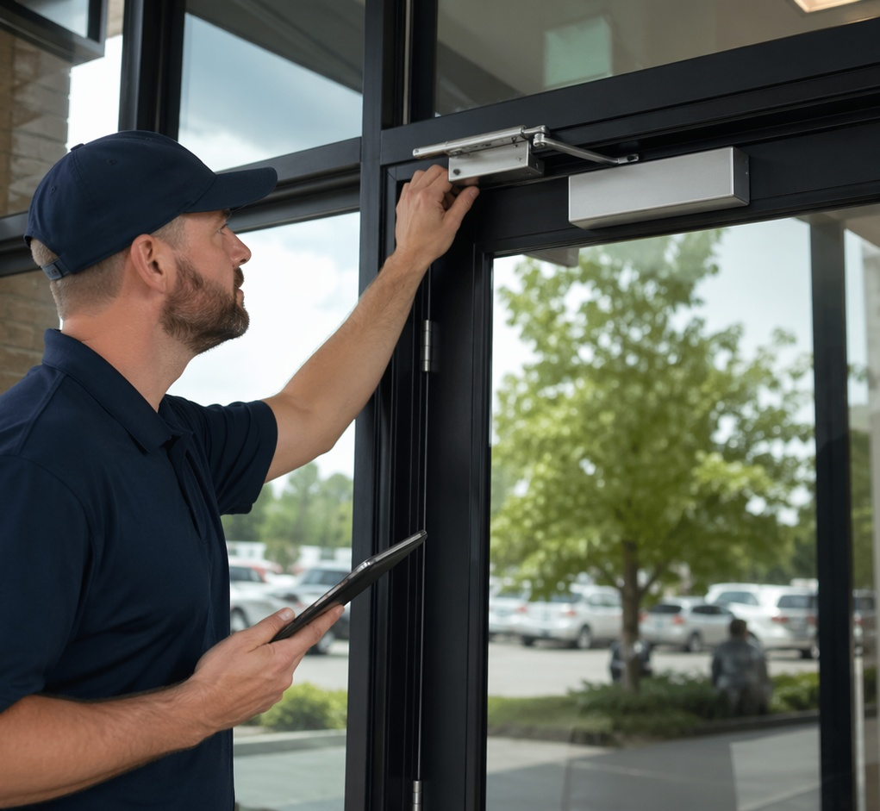
Flexible commercial hour bank
Reserved support for recurring maintenance without constant one-off scheduling.
Predictable capacity
Clients reserve technician hours in advance and apply them across repairs, punch lists, maintenance, turns, and priority needs.
Operational value
The hour bank creates a dependable maintenance resource, helps control costs, and reduces the scramble when small issues pile up.
Best-fit use cases
Rental turnovers, monthly maintenance visits, tenant-requested repairs, common-area upkeep, multi-site punch lists, and recurring safety checks.
SPS Midwest • Protect, Maintain, Elevate
Commercial

Slide 5
Commercial workflow
A clear process from request to completed maintenance.
01
02
03
04
05
Submit request
Triage scope
Schedule correctly
Complete & document
Plan next support
Send issue, photos, property address, access details, and urgency level.
We determine whether it is a service call, urgent visit, walkthrough, or larger bid.
Work routes to the right commercial calendar based on scope, urgency, and property type.
Technicians complete the work, capture notes, and flag follow-up items.
Clients can continue with individual calls or move to recurring route/hour bank support.
SPS Midwest • Protect, Maintain, Elevate
Commercial

Slide 6
Commercial support options
How clients can engage SPS Midwest.
Option
Best for
Value
Commercial Service Call
Single issue / diagnosis
Fast help for specific repair or maintenance items.
Walkthrough & Bid
Projects / multi-unit scope
Clear assessment, prioritized scope, and structured proposal.
Turnover & Make-Ready
Landlords / managers
Prepare spaces for the next tenant faster with fewer vendor handoffs.
Recurring Maintenance Route
Portfolio clients
Predictable visits for ongoing repairs, common areas and preventative upkeep.
Commercial Hour Bank
Repeat commercial clients
Reserved technician hours for punch lists, turns, maintenance and priority needs.
Same-Day Steward
Urgent safety/access issues
Premium response for time-sensitive problems that can disrupt operations.
SPS Midwest • Protect, Maintain, Elevate
Commercial

Slide 7
Same-Day and priority support
Urgent issues get routed for fast stabilization and next-step planning.
Use when time matters
Broken locks, access issues, loose handrails, trip hazards, active leaks, weather issues, and customer-facing repair concerns.
Stabilize first
The first priority is safety, access, and preventing further damage. Follow-up work can be scheduled or quoted after the immediate issue is controlled.
Overflow ready
When a job requires licensed trades or specialized help, vetted subcontractor coordination can extend capacity while SPS remains the main point of communication.
SPS Midwest • Protect, Maintain, Elevate
Commercial

Slide 8
Why commercial clients choose SPS Midwest
Benefits framed around operations and property performance.
Benefit
What it means for the business/property team
Less downtime
Repairs and access issues get handled before they interrupt operations or tenant experience.
Better coordination
One communication point for small repairs, punch lists, turns and follow-up.
Predictable support
Hour banks and routes help clients plan maintenance instead of reacting constantly.
Professional image
Customer-facing spaces, entries and common areas stay safer and better maintained.
Scalable model
One property or several properties can be supported through the same Steward process.
SPS Midwest • Protect, Maintain, Elevate
Commercial

Slide 9
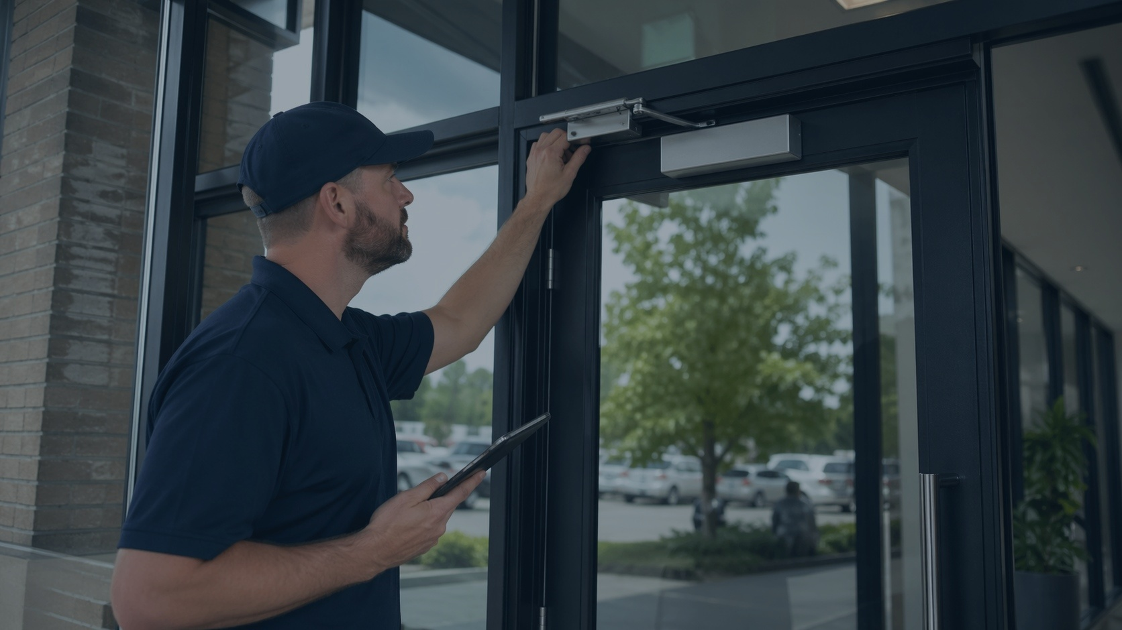
Ready to simplify commercial maintenance?
SPS Midwest helps business owners, landlords, and property managers keep properties safe, functional, and professional.
• Request a service call
• Schedule a walkthrough
• Ask about hour bank support
Click the link to see if you're a fit: Commercial Steward
Call/Text: 463-777-2916 • spsmidwest.com
• customer-care@spsmidwest.com
Commercial brochure

